Slide 1
The Activation Synthesis Research Study
Williams et al. (1992): study into
Bizarreness in Dreams and Fantasies
MASTERCLASS

Slide 2
Background
Hobson and McCarley(1977)- activation-synthesis model (neurobiological)
Near-random patterns of brain activation are combined and interpreted (synthesis) by the brain, resulting in the bizarre (and characteristic) features of dreams.
The model helps to make sense of one of the puzzling features of dreams:
that they often combine the ‘day residue’ of present situations and experiences with memories from years or even decades before.
But…
two brain states of wakefulness (experience fantasies) and REM sleep (experience dreams), which are physiologically different, must also be cognitively (thoughts) different.

Slide 3
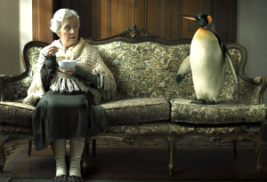
Aim
The aim of this study was to assess the bizarreness in dreams and fantasies as a way of showing support for the activation-synthesis hypothesis of dreaming.

Slide 4
Research Method/design
Natural experiment using the self-report method to gather data to compare people’s experience of dreams
and fantasies (IV).

Slide 5
Self Report
Refer to pages 182-184 and complete the questions and table below
What is a natural experiment?
What is a self report method?
Which research methods could use self report?
Name studies that we have looked at that use self report method?
Copy & complete the table below
Strengths of using a self report method
Limitations of using a self report method

Slide 6
Sample
12 students (2 male, 10 female) enrolled in a biopsychology course at Harvard University Extension School in Cambridge, Massachusetts, USA.
Age range was 23-45 years of age.

Slide 7
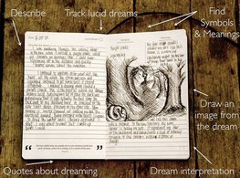
Procedure – data collection
During term time, the students were asked to record, upon waking during the night and in the morning, any and all dreams remembered.
Mental activity occurring during waking was also recorded if it met the following definition of fantasy: apparently spontaneous mentation of a narrative and/or perceptual nature without clear links to external stimuli or conscious intention (these were then considered ‘fantasies’).
All dream and fantasy reports were kept in a written journal.
A total of 60 dreams and 60 fantasies were selected from the journals submitted by the 12 students on the basis of: (i) Length (in excess of 5 lines). (ii) The presence of descriptions of formed visual perceptions.

Slide 8
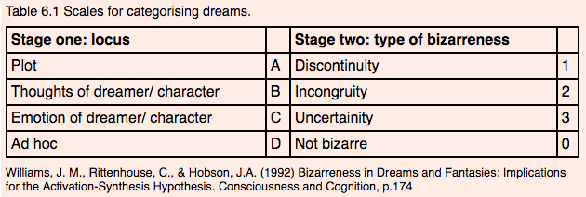
Procedure – data analysis
Reports were divided into one sentence units and scored separately for bizarreness using a bizarreness coding scale devised by Hobson et al. (1987).
Stage 1= the locus of the bizarre item
(where & what was happening)
Stage 2= discontinuity (suddenly stopped),
an incongruity (out of place) or an
uncertainty (not sure or clear).
Three judges scored all 120 reports for bizarreness after the reports had been transcribed and coded randomly to ensure unbiased scoring. Judges worked individually so inter-rater reliability could be determined.

Slide 9
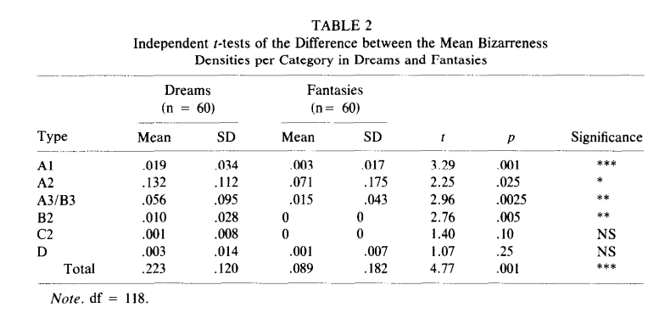
Understand and apply measures of central tendency (mean, mode, median).
Results
Williams et al. (1992), p. 177

Slide 10
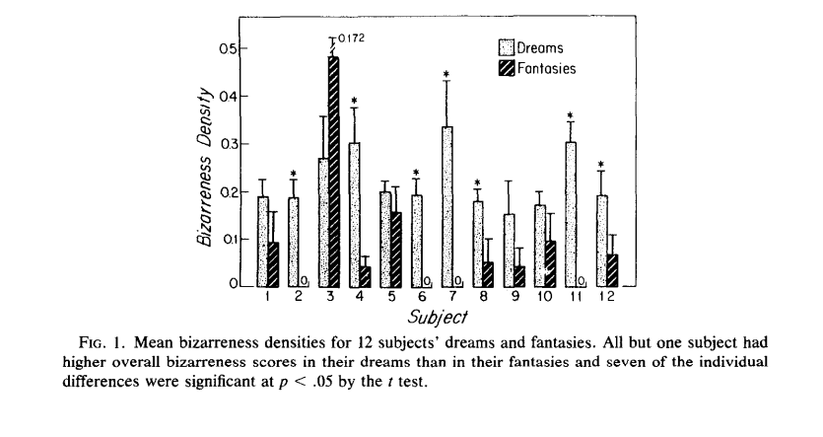
Understand and apply measures of central tendency (mean, mode, median).
Results
Williams et al. (1992), p. 177

Slide 11
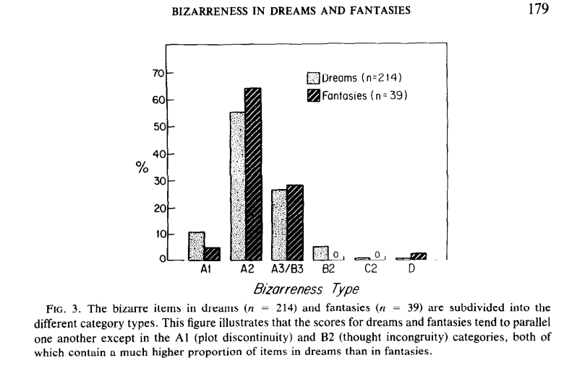
Understand and apply measures of central tendency (mean, mode, median).
Results
Williams et al. (1992), p. 179

Slide 12
Understand and apply measures of central tendency (mean, mode, median).
Results
Judges – good inter-rater reliability = agreed about 80% of the time on both bizarreness and non-bizarre items.
Bizarreness was more than twice as prevalent in dream reports than fantasy reports.
Dreams scored higher than fantasies for: plot discontinuity (greatest difference), plot incongruity, uncertainty, and thought incongruity.
Bizarreness in dreams usually came from nearly all participants whereas bizarreness in fantasies came from only a few participants. • Dreams were always set in remote times or places (12/12 participants) while fantasies were far more often current in both time and place (6/12 participants).
The Maths
Bizarreness Density was calculated by dividing the number of bizarre items scored by the total number of units (i.e. journal entries)

Slide 13
Conclusion
Findings support the activation-synthesis hypothesis which predicts a difference between REM sleep dreams and waking fantasies (due to the difference in the neural activity of the brain between the two states).
Dreams contain more bizarreness as well as other ‘dreamy’ features such as remoteness of time and place than fantasies.
Dreams differ from fantasies in relation to the number of people involved/the remoteness of time/the remoteness of place.

Slide 14
Criticisms
Study relies on self report through the written journals of participants.
+ Social desirability could have been a factor as participants may have been embarrassed of some of their dreams/fantasies and left them out.
There was a lack of control over the independent variables (dreams & fantasies).
+ Participants were reporting from home, could have been writing about dreams from non-Rem sleep and some fantasies could have taken place during drowsiness- this could affect difference found.
Sample was too small & difficult to generalise – only twelve people.
+ There were 120 reports but they only came from 12 people and 10 were female, so it was gender-biased and could affect the nature of dreams and fantasies.

