Slide 1
The Activation Synthesis Research Study
Williams et al. (1992): study into
Bizarreness in Dreams and Fantasies
WORKSHOP & CRITIQUE

Slide 2
New Learning: How does Freud’s Theory of Dreaming explain why we dream?
Next step: How can research into dreaming inform us about the ways that sleep disorders can be treated?
Learning
path
CHECKPOINT Use the calculation from the study (SUM of bizarreness codes divided by number of journal entries) to find the bizarreness density.
Finished?
Go to the Activation Synthesis Theory and Williams et al. study pages on the website and explore the challenge clips.
Make sure that you have also checked your work and improved using PURPLE PEN.
Progress Step 3
EXPLORE & APPLY:
Use your knowledge of the data analysis method in the study to code the example dreams/fantasies and your peer’s dream journals.
Success
Use the Challenge examples from the teacher to practice using Hobson’s Bizarreness scale. Code both examples in purple pen.
In pairs/groups, swap your sleep journal around and take time to code each dream using the scale.
Progress Step 2
EXPLORE & EVALUATE:
Use your understanding from the Masterclass and your knowledge of research to evaluate the limitations of this study.
Success
Outline THREE limitations of the study.
Each limitation should include:
Point about what is limited;
Example from the study (to explain);
Explanation about why it is a limitation.
CHECKPOINT Check your limitation explanations against the models in the textbook or on the webpage. Improve using the purple pen.
Progress Step 1
EXPLORE & PRESENT:
Use your understanding from the Masterclass to present the William et al. study in a study chart.
Success:
1. I have outline the background & aim.
2. I have outlined the research method & sample.
3. I have explained the procedure (data collection
& analysis).
4. I have explained the results and the conclusions.
CHECKPOINT
Use the study summary on the webpage to check your study chart. Add improvements in purple pen.
Prior Learning: understanding the Activation Synthesis Theory (neurobiological explanation of dreaming).

Slide 3
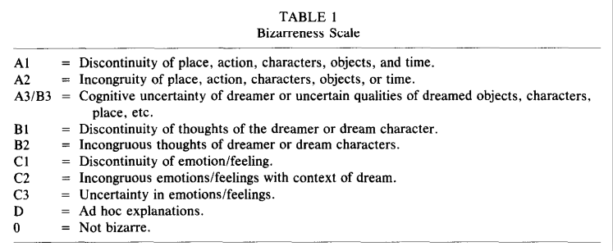
Williams et al. (1992), p. 177

Slide 4
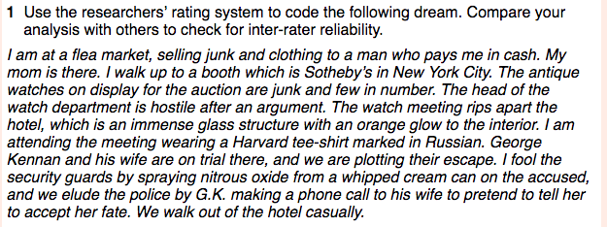
BEING THE RESEARCHER
Analysing Dreams & Fantasies

Slide 5
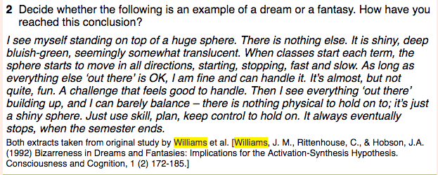
BEING THE RESEARCHER
Analysing Dreams & Fantasies

