Slide 1
Challenge Quiz – Back of your book
What does the term prevalence mean?
Jahoda suggested a definition of good mental health, by listing 6 characteristics a person should have. Name three of them.
What is the name of the other definition of mental health ?
According to current statistics, how many adults have a mental health problem?
a) 1 in 6 b) 1 in 8 c) 1 in 4
What is the most common type of mental health problem?
What does the term stigma mean?
What happened in 1959 which changed attitudes to mental health problems?
CHALLENGE QU: name a charity or campaign which has made changes to attitudes towards mental health problems.

Slide 2
Challenge Quiz – Back of your book
What does the term prevalence mean?
How common something is
Jahoda suggested a definition of good mental health, by listing 6 characteristics a person should have. Name three of them.
Having high self-esteem
Personal growth and self-actualisation
Integration
Autonomy
Accurate sense of reality
Mastery of the environment
What is the name of the other definition of mental health ?
Mental Health Continuum
According to current statistics, how many adults have a mental health problem?
c) 1 in 4
What is the most common type of mental health problem?
Generalised Anxiety Disorder, or Depression
What does the term stigma mean?
A strong sense of disapproval for something
What happened in 1959 which changed attitudes to mental health problems?
The Mental Health Act (1959)
Name a charity or campaign which has made changes to attitudes towards mental health problems.
Time To Change, Changing Minds, World Mental Health Day

Slide 3
Schizophrenia: The Clinical Characteristics
MASTER CLASS
Learning aim: Understand how a person gets a diagnosis of schizophrenia
Know the definition of schizophrenia
Understand some of the symptoms of schizophrenia
Identify symptoms of schizophrenia in a scenario
Key Terms:
Schizophrenia Symptoms
Diagnosis Psychotic
Characteristics

Slide 4
Schizophrenia: The Clinical Characteristics
Write a definition – What do you think SCHIZOPHRENIA is?
A psychotic disorder where people lose their sense of self and reality
LO: Understand how a person gets a diagnosis of schizophrenia
KNOW THE DEFINITION OF SCHIZOPHRENIA
UNDERSTAND SOME OF THE SYMPTOMS OF SCHIZOPHRENIA
IDENTIFY SYMPTOMS OF SCHIZOPHRENIA IN A SCENARIO

Slide 5
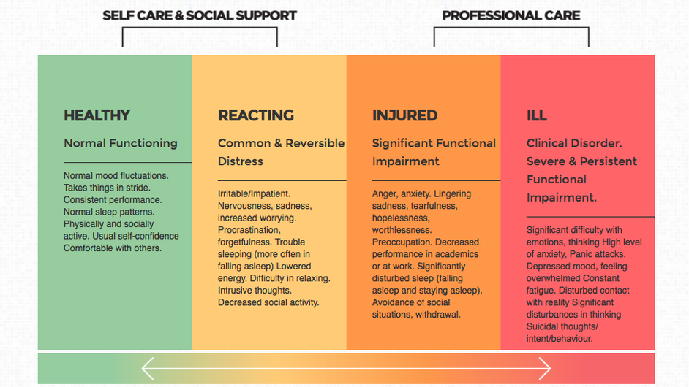

Slide 6
About Schizophrenia
Schizophrenia: The Clinical Characteristics
Schizophrenia is one of the most significant mental health disorders that a person can be diagnosed with as it is very severe and can last a lifetime.
Schizophrenia comes from Latin and can literally be translated as “Split Mind”. It is a disorder where individuals lose touch with reality.
LO: Understand how a person gets a diagnosis of schizophrenia
KNOW THE DEFINITION OF SCHIZOPHRENIA
UNDERSTAND SOME OF THE SYMPTOMS OF SCHIZOPHRENIA
IDENTIFY SYMPTOMS OF SCHIZOPHRENIA IN A SCENARIO

Slide 7
In your tables…
Schizophrenia: The Clinical Characteristics
Discuss – How would you know if someone had schizophrenia?
Each person needs to create a mindmap in your book of the answers.
Be ready to feedback!
LO: Understand how a person gets a diagnosis of schizophrenia
KNOW THE DEFINITION OF SCHIZOPHRENIA
UNDERSTAND SOME OF THE SYMPTOMS OF SCHIZOPHRENIA
IDENTIFY SYMPTOMS OF SCHIZOPHRENIA IN A SCENARIO

Slide 8
Diagnosing Schizophrenia
Schizophrenia: The Clinical Characteristics
The International Classification of Diseases (ICD) is a manual of mental disorders and their symptoms.
It is used by medical professionals to diagnose mental health problems.
LO: Understand how a person gets a diagnosis of schizophrenia
KNOW THE DEFINITION OF SCHIZOPHRENIA
UNDERSTAND SOME OF THE SYMPTOMS OF SCHIZOPHRENIA
IDENTIFY SYMPTOMS OF SCHIZOPHRENIA IN A SCENARIO

Slide 9
Diagnosing Schizophrenia
Schizophrenia: The Clinical Characteristics
The ICD states that for a person to be diagnosed with schizophrenia, they will present symptoms most of the time during an episode of psychotic illness lasting at least one month.
The symptoms will be at least one from column A, or two from column B in the table below.
You have a printed copy of the table – read through and glue in to your book
LO: Understand how a person gets a diagnosis of schizophrenia
KNOW THE DEFINITION OF SCHIZOPHRENIA
UNDERSTAND SOME OF THE SYMPTOMS OF SCHIZOPHRENIA
IDENTIFY SYMPTOMS OF SCHIZOPHRENIA IN A SCENARIO

Slide 10
Diagnosing Schizophrenia
Column A (at least 1 of) | Column B (at least 2 of)
Thought Echo, Thought Insertion or withdrawal, or Thought Broadcasting | ‘Negative’ symptoms such as marked apathy, paucity of speech, and blunting or incongruity of emotional responses
Delusions of Control, influence or passivity, clearly referred to body or limb movements or specific thoughts, actions, or sensations; delusional perception | Neologisms, breaks or interpolations in the train of thought, resulting in incoherence or irrelevant speech
Hallucinatory voices giving a running commentary on the patient’s behavior, discussing him between themselves, or other types of hallucinatory voices coming from some part of the body | Catatonic behaviour, such as excitement, posturing or waxy flexibility, negativism, mutism or stupor
Persistent delusions of other kinds that are culturally inappropriate and completely impossible (e.g. being able to control the weather, or being in communication with aliens from another world). | Persistent hallucinations in any modality, when occurring every day for at least one month when accompanied by delusions without clear, affective content, or when accompanied by persistent over-valued ideas

Slide 11
Symptoms of Schizophrenia
Schizophrenia: The Clinical Characteristics
The symptoms of schizophrenia are categorised easier using the following terms:
Thought disturbances
Delusions
Hallucinations
Disorganised speech
Catatonic behavior
Negative symptoms
Each of these links with a box on the table.
LO: Understand how a person gets a diagnosis of schizophrenia
KNOW THE DEFINITION OF SCHIZOPHRENIA
UNDERSTAND SOME OF THE SYMPTOMS OF SCHIZOPHRENIA
IDENTIFY SYMPTOMS OF SCHIZOPHRENIA IN A SCENARIO

Slide 12
Symptoms of Schizophrenia
Schizophrenia: The Clinical Characteristics
Read through and identify each of the following symptoms in the case study of Peter.
Thought disturbances
Delusions
Hallucinations
Disorganised speech
Catatonic behavior
Negative symptoms
LO: Understand how a person gets a diagnosis of schizophrenia
KNOW THE DEFINITION OF SCHIZOPHRENIA
UNDERSTAND SOME OF THE SYMPTOMS OF SCHIZOPHRENIA
IDENTIFY SYMPTOMS OF SCHIZOPHRENIA IN A SCENARIO

Slide 13
The Case Study of Peter
Peter was diagnosed with schizophrenia at the age of 23. He claimed to hear voices of secret agents who were plotting to kidnap him. He strongly believed that the agents were able to read his mind and that they were intercepting his thoughts as they left his head. He was convinced that he was in real danger and as a consequence locked himself in his flat for days on end.
On one occasion, when his brother broke in and found him, Peter was sitting in a chair but in a contorted, uncomfortable way. His brother described Peter as being statue-like and completely unresponsive. Peter has spent time on a psychiatric ward. On the ward, Peter became very agitated and spoke almost constantly – although there was little substance or meaning to anything that he said.
His symptoms subsided after a while and, following drug treatment, he was allowed to back to his family home. Since being back with his parents, Peter has become very withdrawn and seems to lack any motivation.

Slide 14
Schizophrenia: The Clinical Characteristics
WORKSHOP
Learning aim: Understand how a person gets a diagnosis of schizophrenia
Know the definition of schizophrenia
Understand some of the symptoms of schizophrenia
Identify symptoms of schizophrenia in a scenario
Key Terms:
SchizophreniaSymptoms
Diagnosis
Psychotic
Characteristics

Slide 15
New Learning: Understand how a person gets a diagnosis of schizophrenia.
Next step: Exploring theories on schizophrenia
Learning
path
Progress Step 3
EXPLORE & EVALUATE:
How symptoms are presented and how they affect individuals
Success
Conduct a case study using the ‘Living with Schizophrenia’ worksheet and watching the documentary on the website: https://passmorespsychology.weebly.com/schizophrenia---theories.html .
Progress Step 2
EXPLORE & REPRESENT:
The symptoms of schizophrenia
Success:
Create a leaflet for a psychiatrist’s waiting room outlining the symptoms of schizophrenia.
Progress Step 1
EXPLORE & PRESENT:
Key terms within the symptoms of schizophrenia
Success:
Research the meanings of new words in the table of symptoms, and create a glossary of them.
Make sure that you have a clear definition for each.
RESOURCES: have your textbook and go to https://passmorespsychology.weebly.com/the-basics.html

